Slide 1
Forecasting stock market returns with economic data
Paolo Ferraro

Slide 2
How can we forecast the stock market?
Complicated to forecast stock market due to how unpredictable it is and how dependent on many variables it is
Use economic variables to analyse relationships:
- Real GDP growth - Gold price
- CPI: inflation measure - Unemployment rate
- Euro/Dollar exchange rate - Interest rate
- VIX: market volatility
Used these variables to find relationships with the stock market and forecast
The recurring theme of the project was to select efficient models by selecting them based on minimising error terms and the AIC value

Slide 3
Structure of the project
Part 1: Correlation analysis to assess cyclicality and relationships with economic variables
Part 2: Forecasting with ARIMA models
Part 3: Beyond ARIMA models: Machine Learning models

Slide 4
Process
Step | Tool used | Purpose | Outcome
1 | Python | To extract latest financial data of sector stock market prices with APIs | Sector specific stock market downloaded from Yahoo Finance, for economic variables found data from IMF, OECD and FRED
2 | SQL | To clean the data, join relevant variables together to have clean tables, interpolate quarterly data into monthly data to have consistent time frequency, summarise data | Cleaned data with consistent time frequency (tabulated quarterly and monthly data)
3 | R | To code forecasting models, test them and compare them to see decide which one is better | Correlation values, ARIMA models, ML models, comparisons of error terms and visual comparisons, predictions
4 | Excel/Tableau | To QA and visualise results | Regression results table, forecasting comparisons chart, QAd data

Slide 5
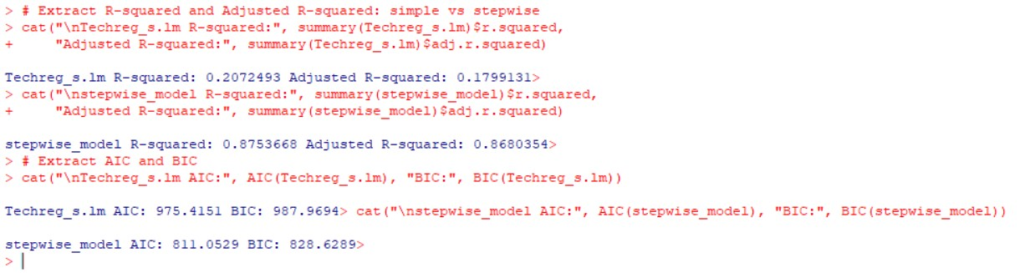
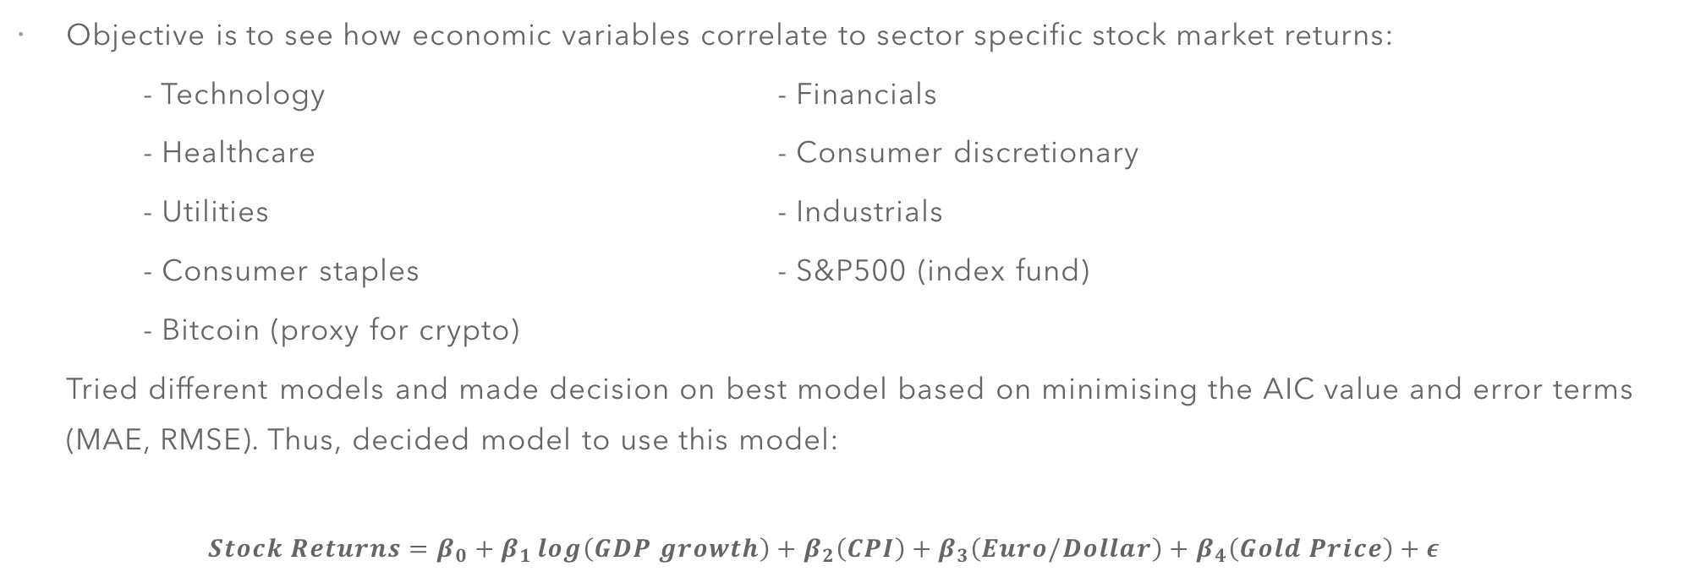
Part 1: How to choose the best regression model
Objective is to see how economic variables correlate to sector specific stock market returns:
- Technology - Financials
- Healthcare - Consumer discretionary
- Utilities - Industrials
- Consumer staples - S&P500 (index fund)
- Bitcoin (proxy for crypto)
Tried different models and made decision on best model based on minimising the AIC value and error terms (MAE, RMSE). Thus, decided model to use this model:
$$Stock Returns=β_{0}+β_{1}\log\left(GDP growth\right)+β_{2}\left(CPI\right)+β_{3}\left(Euro/Dollar\right)+β_{4}\left(Gold Price\right)+ε$$

Slide 6
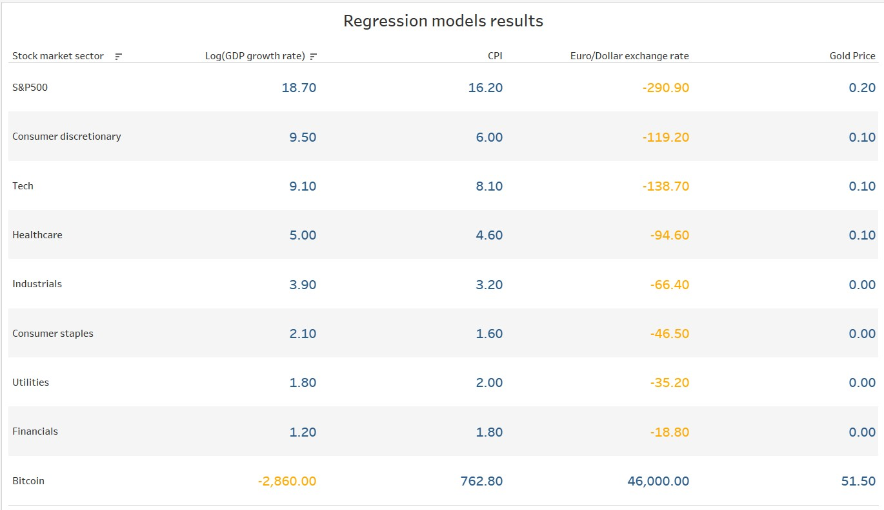

Slide 7
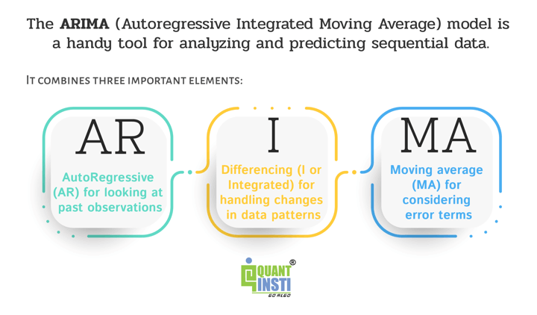
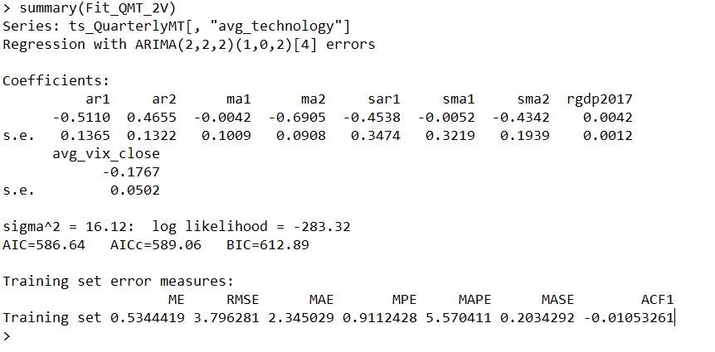
Part 2: How to choose the best forecasting model?
There are different types of forecasting models
ARIMA models: Autoregressive Integrated Moving Average
Selected model with lowest AICc and error terms
AR: use past observations of variables as regressors, I: Integrated, to deal with changes in patterns, MA: Moving Averages, for error terms
How many ARs, MAs, I or no I? R automates these decisions with the auto.arima() function

Slide 8
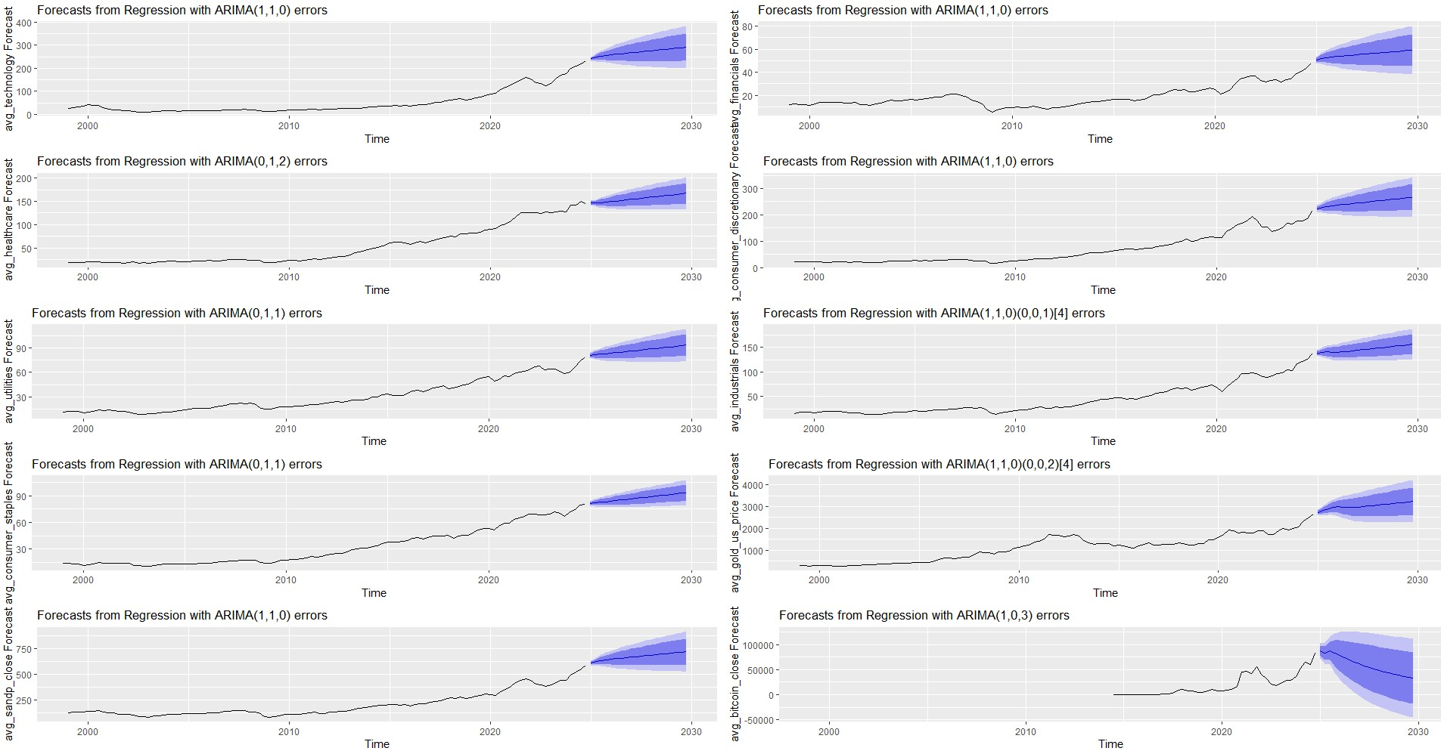
Forecasts: ARIMA(AR lags, differencing, MA lags)(seasonal AR, seasonal diff., seasonal MA)[observations per seasonal period]

Slide 9
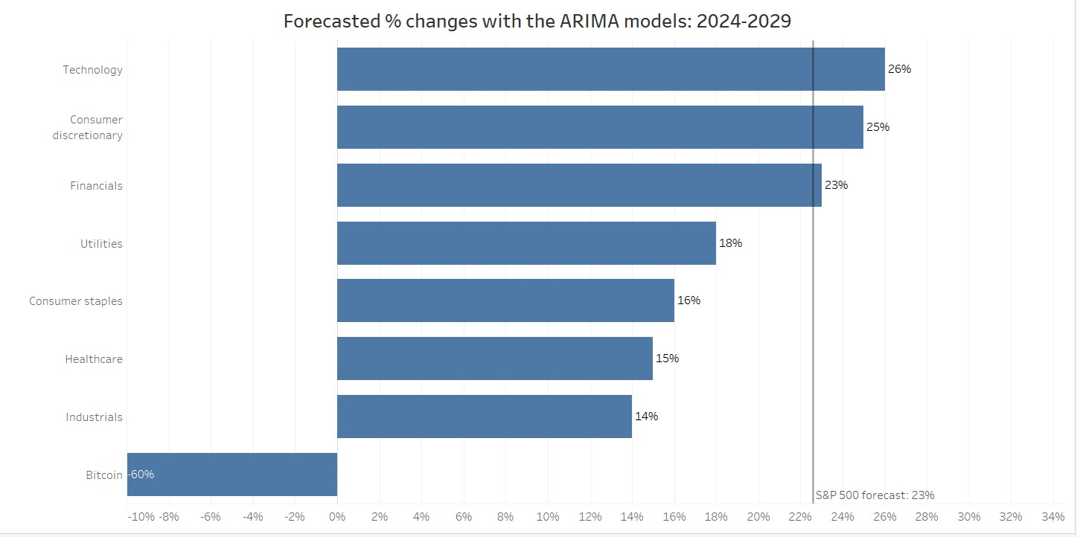
Forecasts results: sector comparison

Slide 10
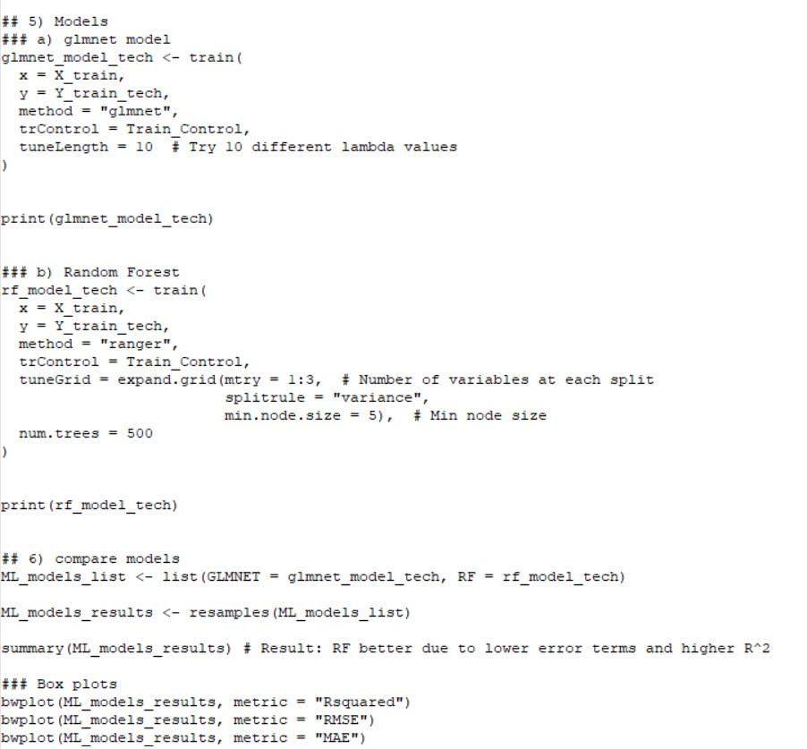
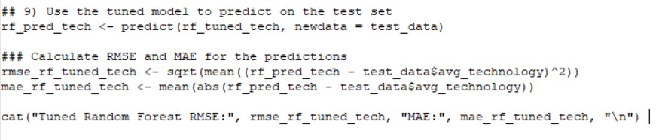
Part 3: GLMNET vs Randon Forest
Data divided into train and test data (e.g. 80-20 split)
GLMNET: Regularised regression model (reducing overfitting)
Random Forest: Ensemble learning model based on decision trees, randomly samples subsets of data to build multiple decision trees
Which one is better for this data? Look into the error terms and the R squared
The smaller the error terms the better, the higher the R squared the better
Test on the train and test data

Slide 11
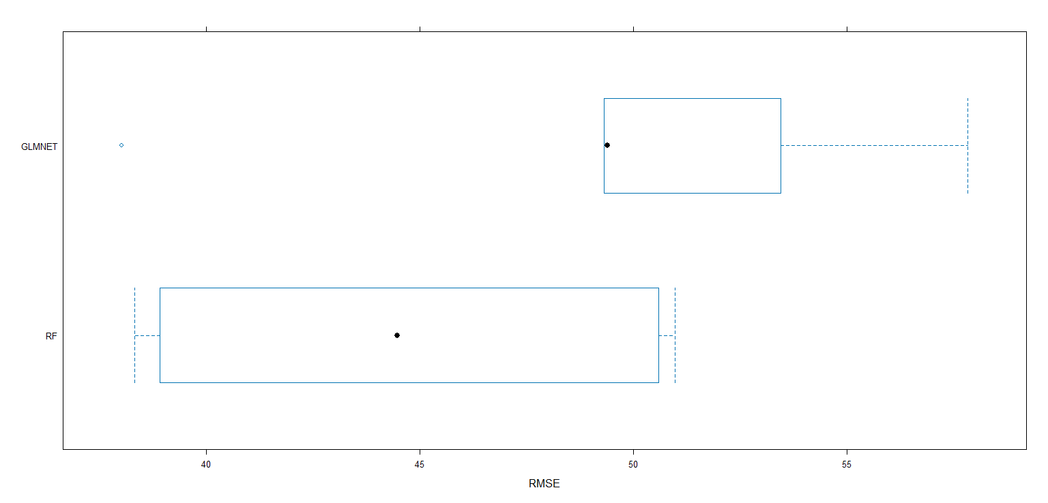
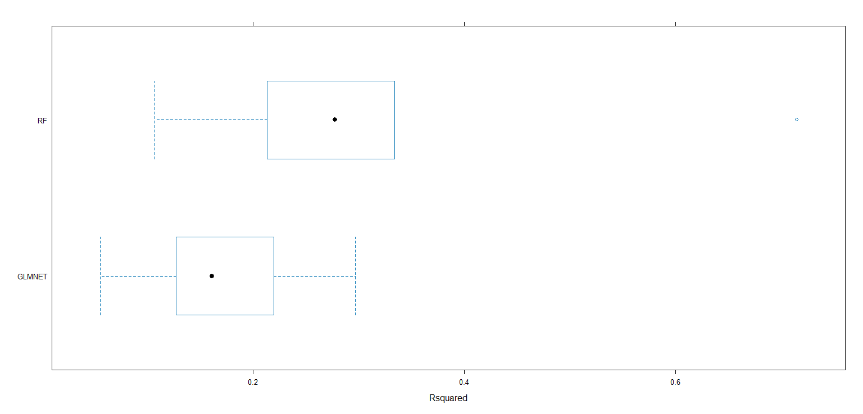
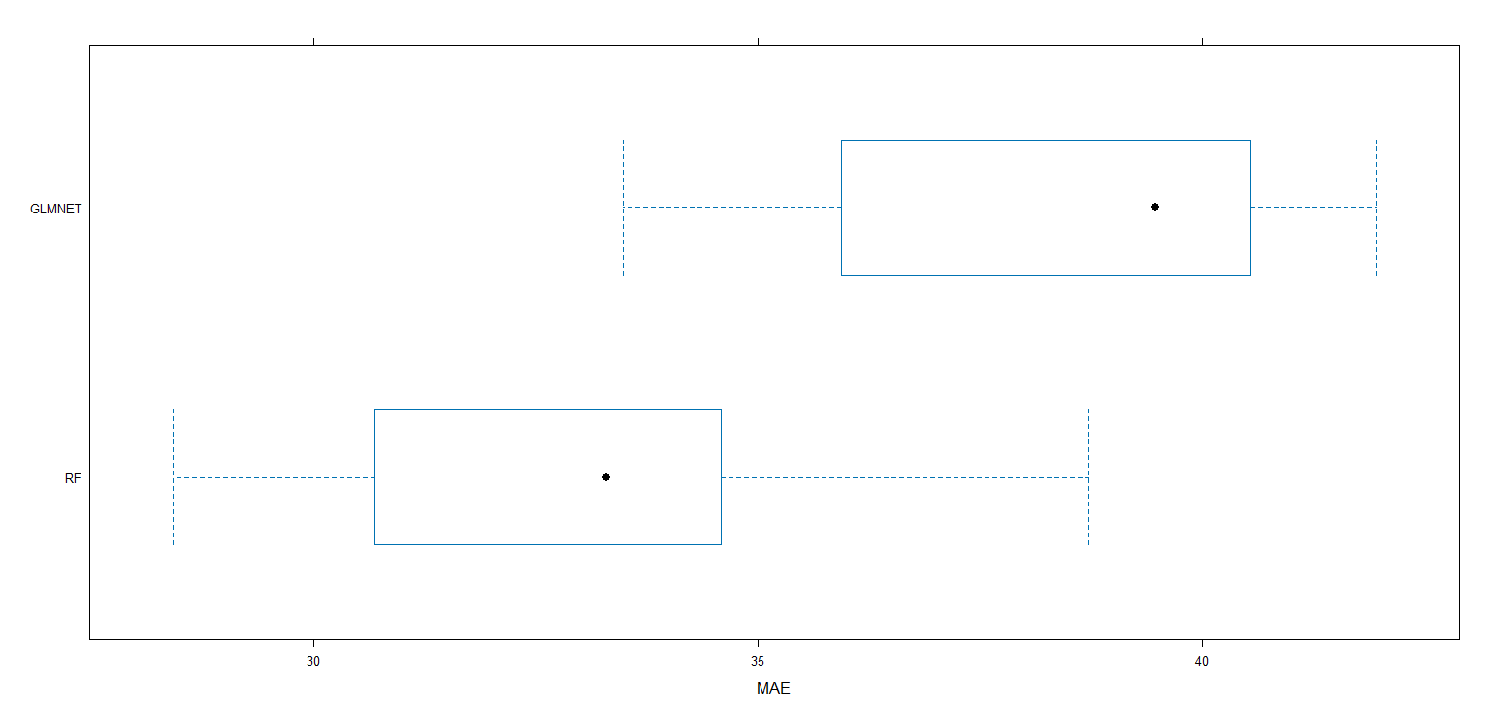
Error terms: GLMNET vs Random Forest

Slide 12
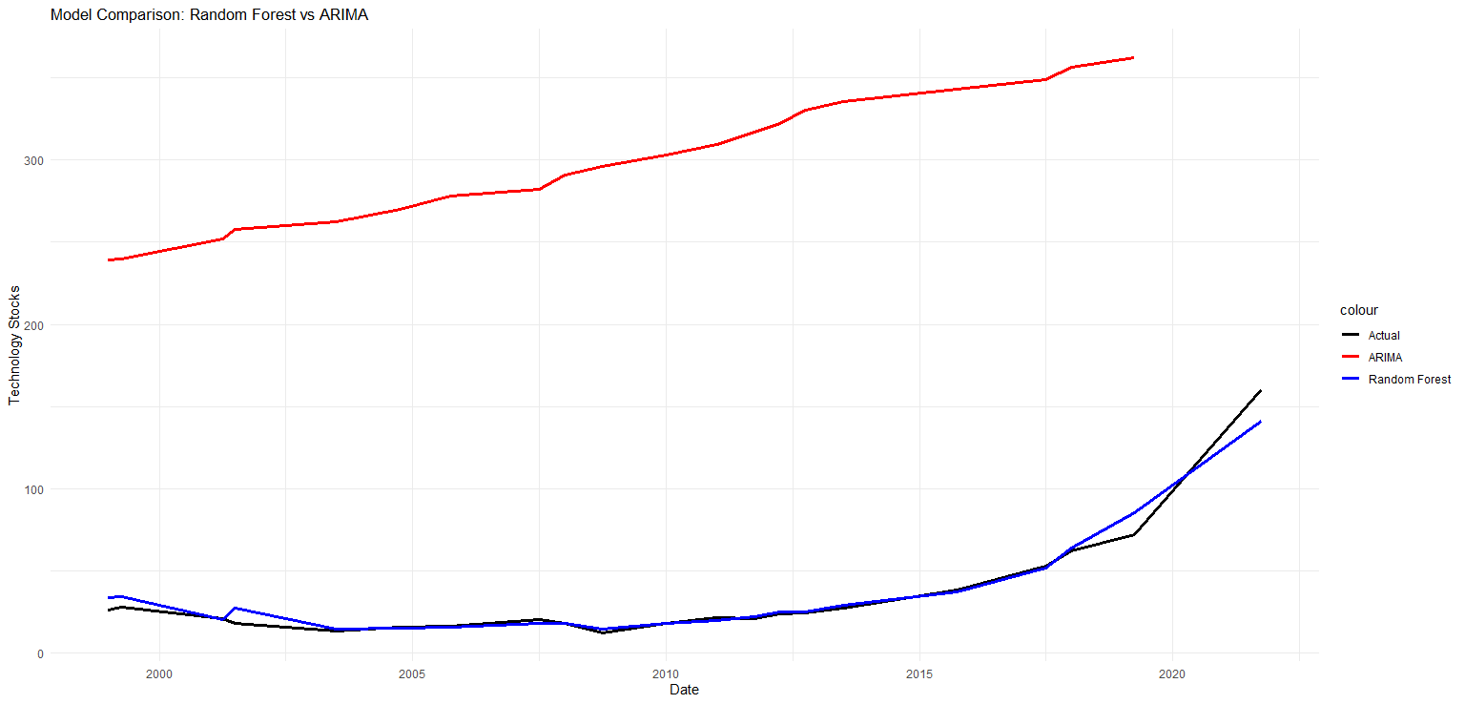
Further analysis: Random Forest can help us predict values better than ARIMA models

